Slide 1


Slide 2

Interior Designing Application
Supervised by:
Mr. Yasir Ali Shah
Group Members:
Ammara Sajjad (FA17-BSCS-071)
Syeda Masooma Zehra (FA17-BSCS-078)
Presented on 7th December 2020
Department of Computer Science
COMSATS University Islamabad, Attock Campus

Slide 3

Outline
_______________________________
Introduction
Related Work
Problem Statement
Objectives
Methodology
Features
Modern Tools
Benefits
Time Line
References

Slide 4
Introduction
This project is about Interior Designing that provide lots of facilities to the customers.
This is an online Android Application for different events designing.
It will assist in designing for those people who have lack of expertise so that they can design their events efficiently.

Slide 5
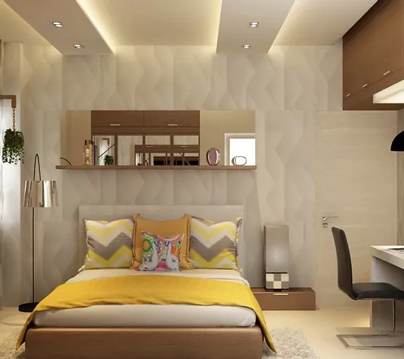
Introduction
As Project deals with:
Residential Interiors

Slide 6

Introduction
Commercial Interiors

Slide 7
Related Work
Other interior designing online companies are:
PFuner E-Design Service
Houzz Online Interior Design AR Tool
Traci Connell Design Delivered

Slide 8
Problem Statement
People are less involve in online interior designing because they feel difficulty to design their interior so we are providing an application that has many features.
To facilitate the people that are busy in their tough schedule and have lack of expertise to manage their events according to their requirements.

Slide 9
Objectives
To provide a platform of interior designing for users.
To create an application which will assist in designing multiple categories and subdivided categories of events.
To facilitate the user by different teams of designers.
To take feedback for the purpose of evaluation.

Slide 10
Objectives
To generate an estimated bill for demanded services before placing an order.
To provide chatting facility by Chatbot.
To facilitate the customer needs, sample images will be displayed through artificial intelligence.
To provide real look and feel to the customer ,customization option through image processing.

Slide 11
Methodology
The requirements of customers will be fulfilled in the field of interior designing through Artificial Intelligence, Machine Learning and Image Processing.
The methodology of this Android Application is:

Slide 12
Estimated bill
Chat
Subdivided categories
Items can buy
Items positioning
Events
Customers
Login /
Register
Customer interface
Coloring scheme
Displaying pics through artificial intelligence
Start
Multiple Teams
Sample exist?
Teams
Yes
Teams interface
Customer Details
Fingerprint recognition
Feedback
Rating
No
Get register
Record not found

Slide 13
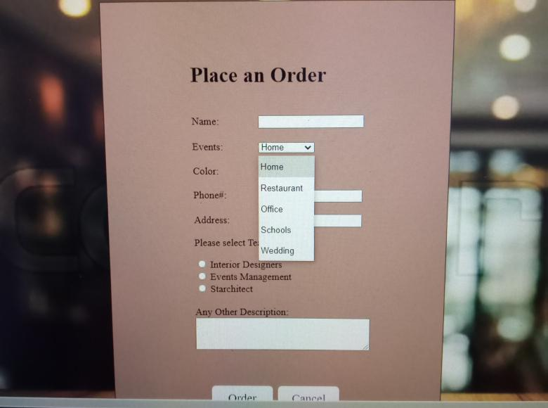
Features
Different events

Slide 14
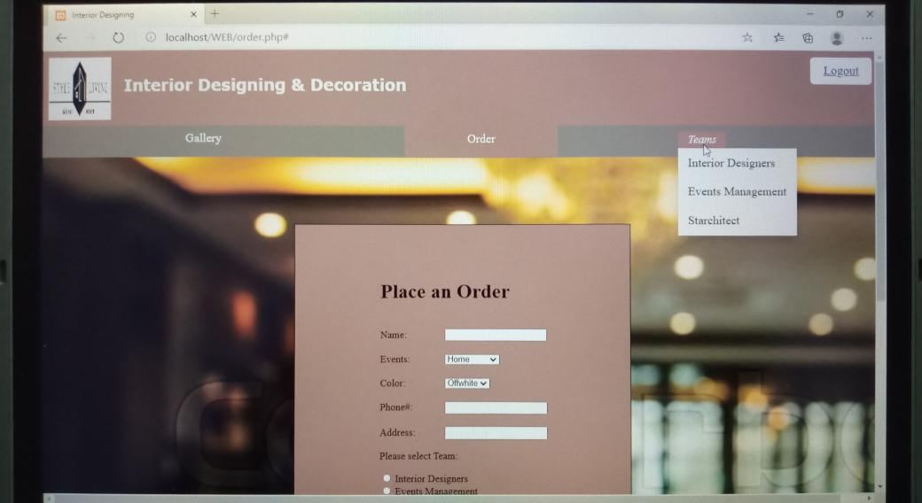
Features
Multiple teams

Slide 15
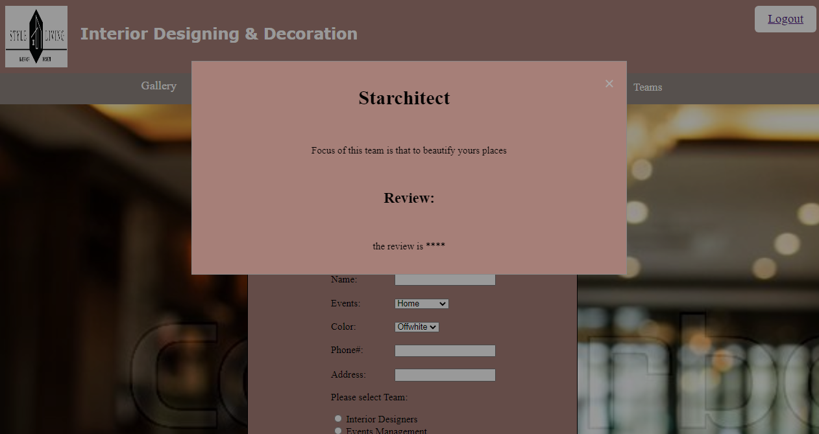
Features
Teams rating

Slide 16
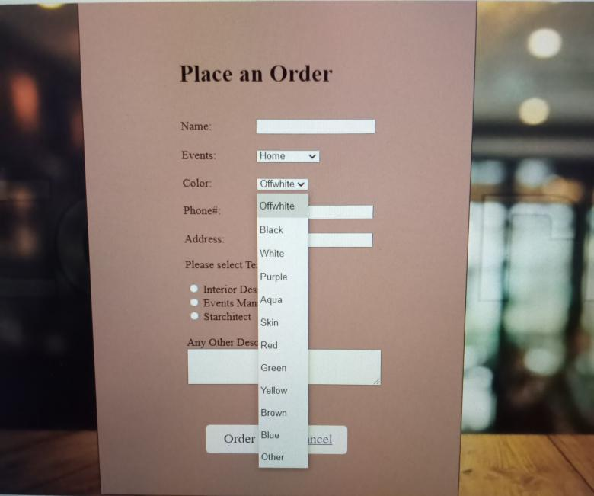
Features
Coloring Scheme (image display)

Slide 17
Other Features
Fingerprint recognition for team’s security.
User can update and cancel their order in specific time.
Subdivided services (furniture, floors, wall’s color, curtains and catering etc.)
Team’s feedback and rating.

Slide 18
Other Features
Chatting through Chatbot.
Sample themes that will display through AI.
Item positioning through image processing.
Estimated bill.

Slide 19
Modern Tools
Tools | Version | Rationale
Python | 3.7.6 | Artificial Intelligence
Firebase | 7.1.0 | Database
Android studio | 3.5 | Programming
MS word | 2019 | Documentation
MS Power Point | 2019 | Presentation

Slide 20
Benefits
Application will give following benefits:
Offers lots of services to save time.
Sample pictures (through AI).
Different categories of events.
Specific teams (Ratings).
Chatting Facility.
Real Environment (through image processing).

Slide 21
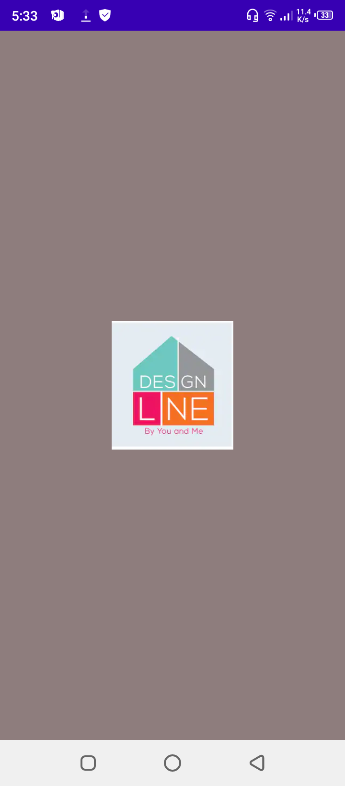
User Interface: Splash Activity
There are 5 activities in implementation work.
First activity contain splash that is the main icon when application starts.

Slide 22
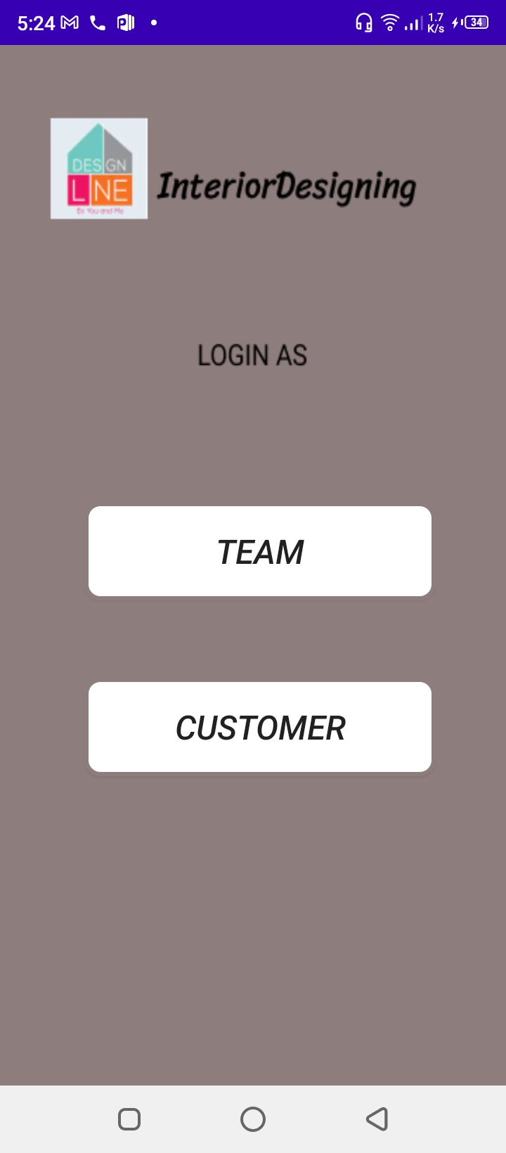
Home Screen: Login As Activity
Then after splash activity there is Login As activity from where the user chooses one of the panel/mode where he want to login according to their requisite.

Slide 23
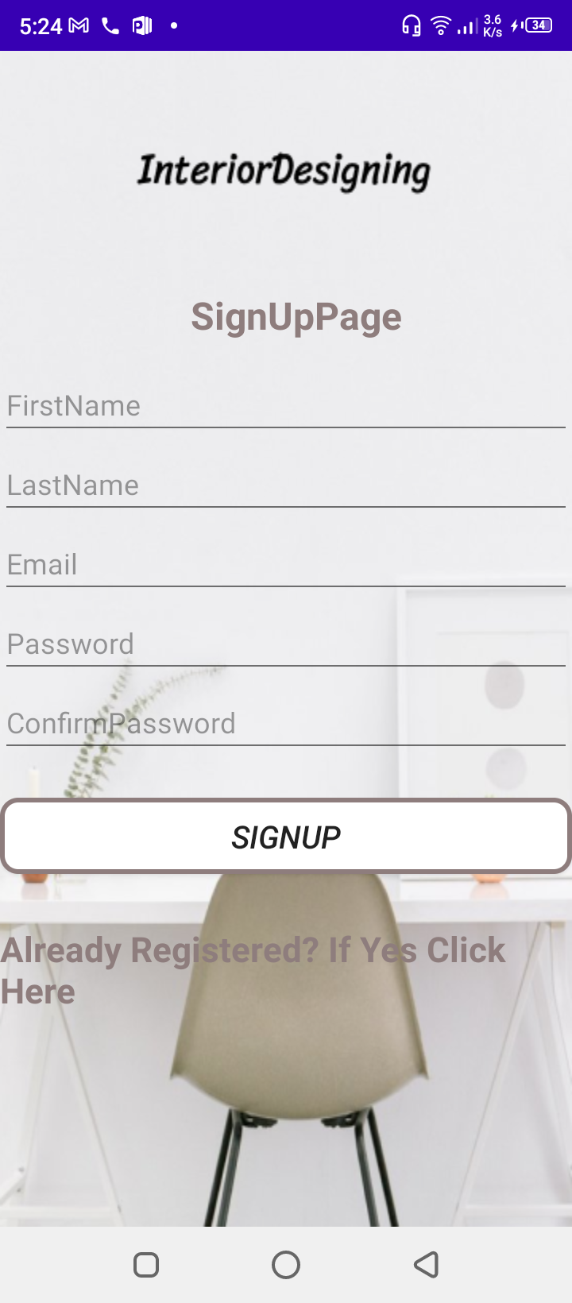
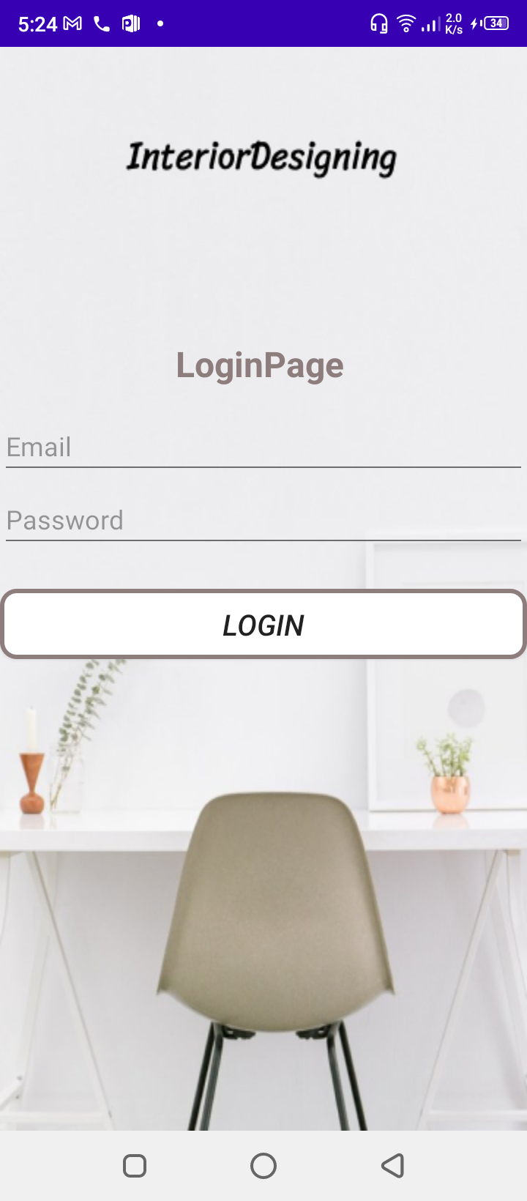
Home Screen: Signup and Login Activity
After selecting any mode, user enters into Login activity and if they are not already registered then go to Signup activity for making an account.

Slide 24
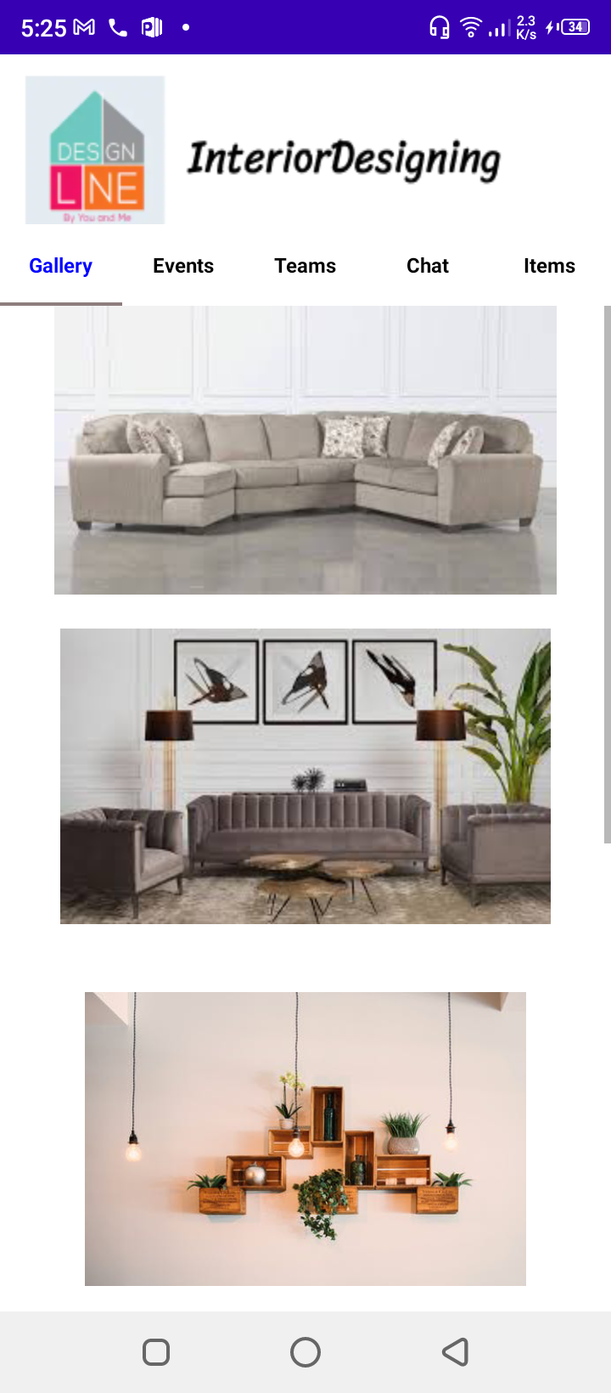
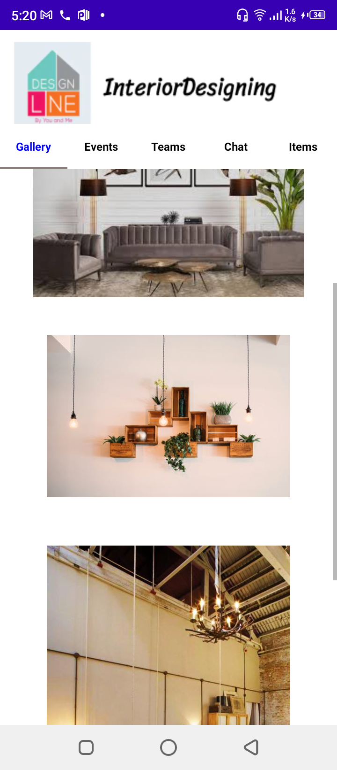
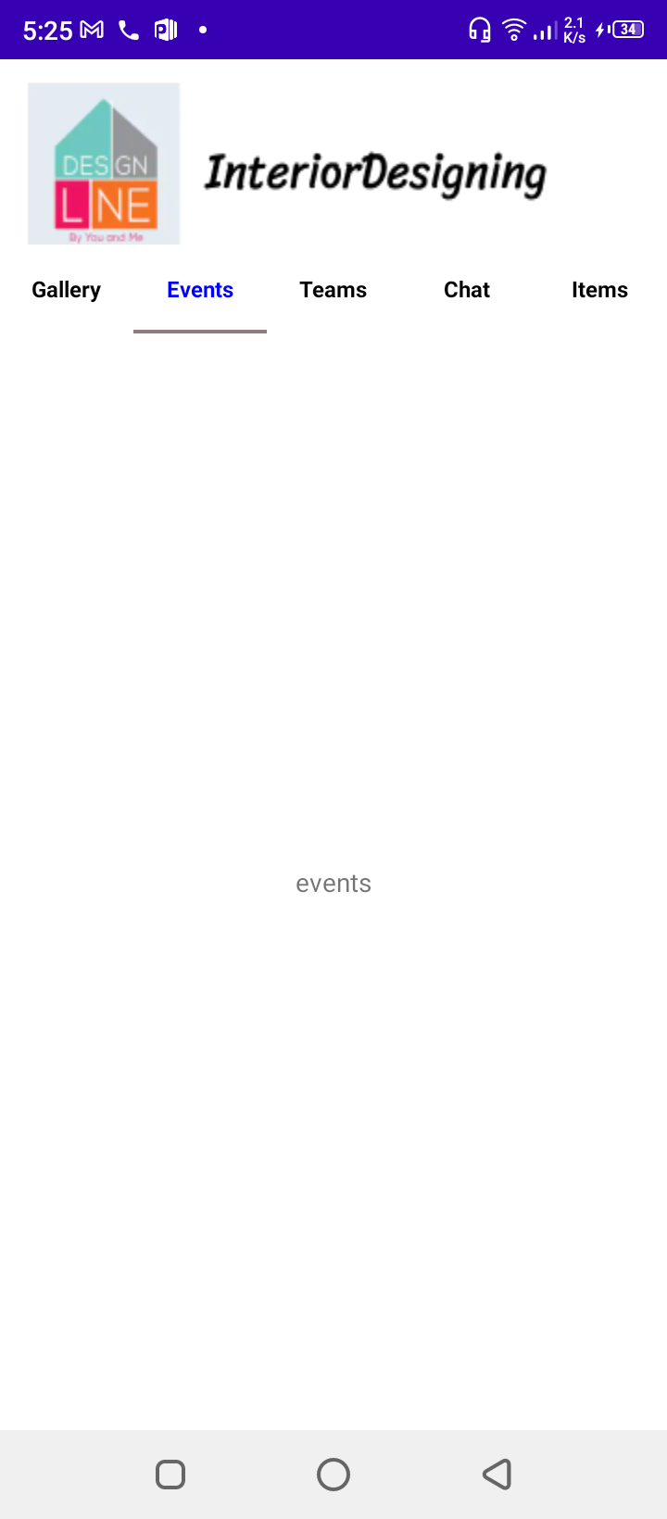
Home Screen: Customer Interface (Gallery)
After having an account, user must be customer so he see Customer Interface in which gallery opens at first step to show some related work of our application to gain user interest.

Slide 25
Time Line
Milestone | Feb to April 2020 | April to June 2020 | June to Sep 2020 | Sep to Nov 2020 | Nov 2020 to Jan 2021 | Jan to March 2021 | March to May 2021
Literature Review
Designing
Programming
Artificial Intelligence
Interface
Testing
Documentation

Slide 26
References
https://pfunerdesign.com/
https://www.houzz.com/mobileApps
https://traciconnellinteriors.com/online-design/

Slide 27


